Slide 1


Titolo presentazione sottotitolo
Office Building
Milano, XX mese 20XX
Schiavo Daniele
Gilberto Pozzi
Manuel Rossi

Slide 2
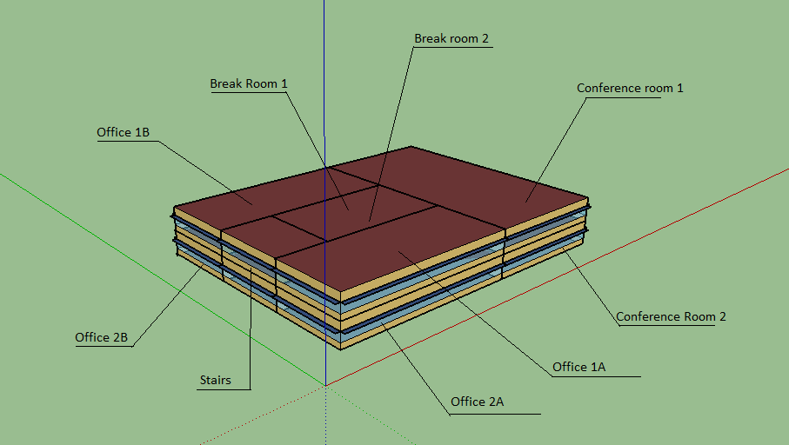
Office Building: Presentation

Slide 3
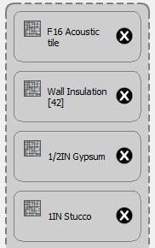
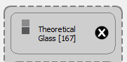
Base Case
We did not modify all the sets, we just created a new external wall composition and one type of window. All the other features are left by default (schedule time, number of people…etc)
Wall Composition
Glazing Material

Slide 4
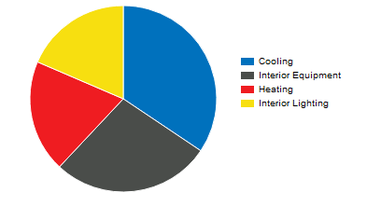
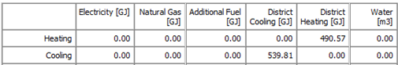
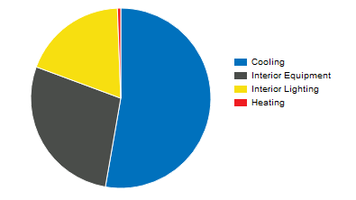
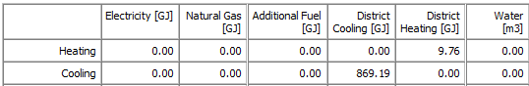
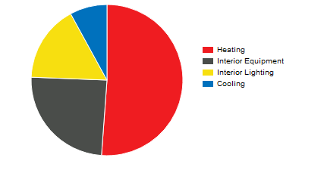
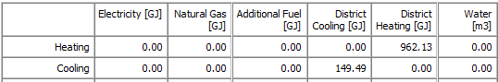
Base Case Result: Piacenza, Nairobi, Oslo
Piacenza
Nairobi
Oslo

Slide 5
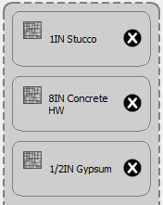
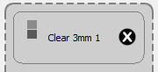
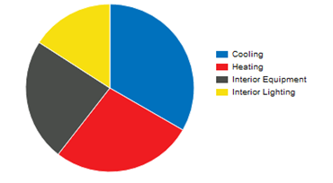
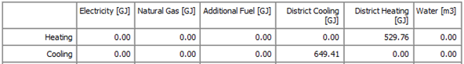
Worst Case: Piacenza
New Wall
New Window

Slide 6
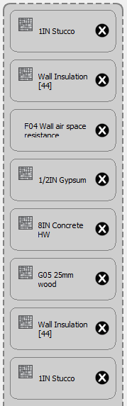
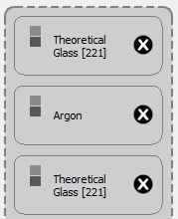
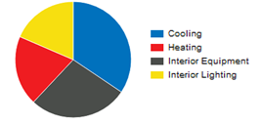
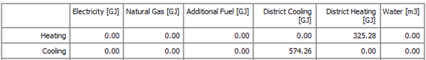
Best Case: Piacenza
Wall
Window

Slide 7
Conclusion
Base Case Piacenza
Best Case Piacenza

